Slide 1
Block chain based crime record management system
Anaswara K P

Slide 2
CONTENTs
Relevance of Topic
Project Description
Objectives of Study
Existing System and Proposed System
Input/ Output and Modules identified
A description of Methodology or System Design or Algorithms to be used.
Dataset used

Slide 3
Relevance of the topic
Criminal records are highly sensitive public records. By incorporating case records of A police station in A blockchain, authenticity and rigidity of records can be maintained.
It also helps to keep the data safe from adversaries.
A criminal record storage system by implementing blockchain technology to store the data, which helps to attain integrity and security is introduced

Slide 4
DescriPTION OF THE TOPIC
Block chain technology is a technology that uses decentralized ledgers to keep transaction records.
Thereby it provides:
Security
Transparency
Less transaction time
No middle-men in transaction
A peer to peer cloud network enables the decentralization of data. It helps prevent unlawful changes in the data.
Here A criminal record storage system based on blockchain technology is used to store the data, which helps to attain integrity and security is introduced. Our system presents ways in which the authority can maintain the records of cases efficiently

Slide 5
Objectives of study
To integrate blockchain with crime record :
To provide a method to secure the FIR system using blockchain technology
To provide better transparency and security to data.

Slide 6
EXISTING SYSTEM AND PROPOSED SYETEM
In existing system we does not have any computerizes system to trace the crime record history and data tempering tracing technic. Police station are register FIR on computer system and then changed after the political pressure or higher authority police officers pressure. So data cannot contain integrity and people cannot get justice . so we are make this system for police station crime records to store data secure.

Slide 7
Existing System and Proposed System
Existing System
Proposed System
Centralized system
Lack of transparency
More chance of manipulation
Decentralized.
Ensure transparency.
No manipulation.

Slide 8
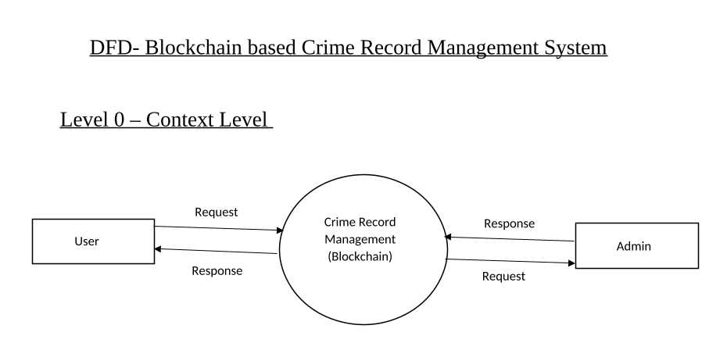
Data flow diagram

Slide 9
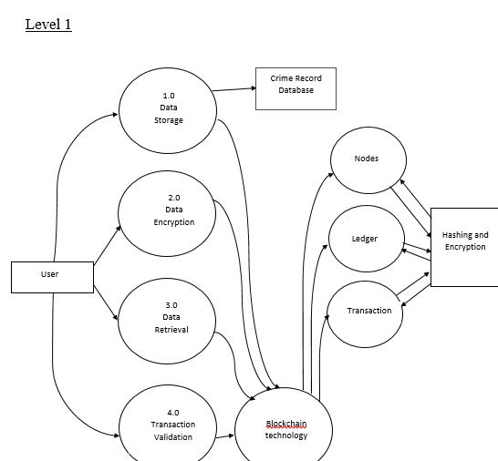

Slide 10
Modules identified
Data storage
Data encryption
Data retrieval
Transaction validation

Slide 11
algorithm
SSH(secure shell)algorithm:
Used for encryption
Encrypting the valid data and store,only admin can decrypt data using his private secret key to view

Slide 12
Thank you

